Slide 1
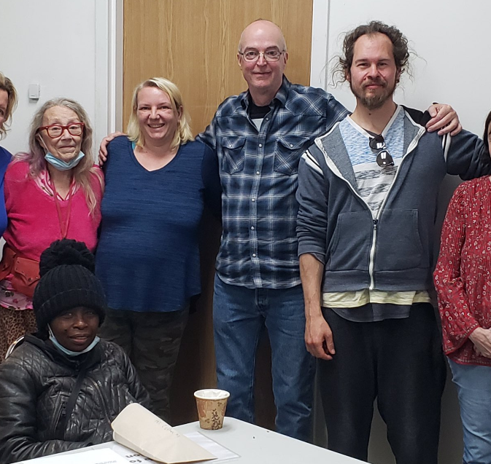
Random Dream team picker
By Andrus & Mariliis

Slide 2

Project goals
Easy program
Random team generator using Java and MySQL database
Good teamwork
Getting smart
After work fun
Trying our new skills

Slide 3

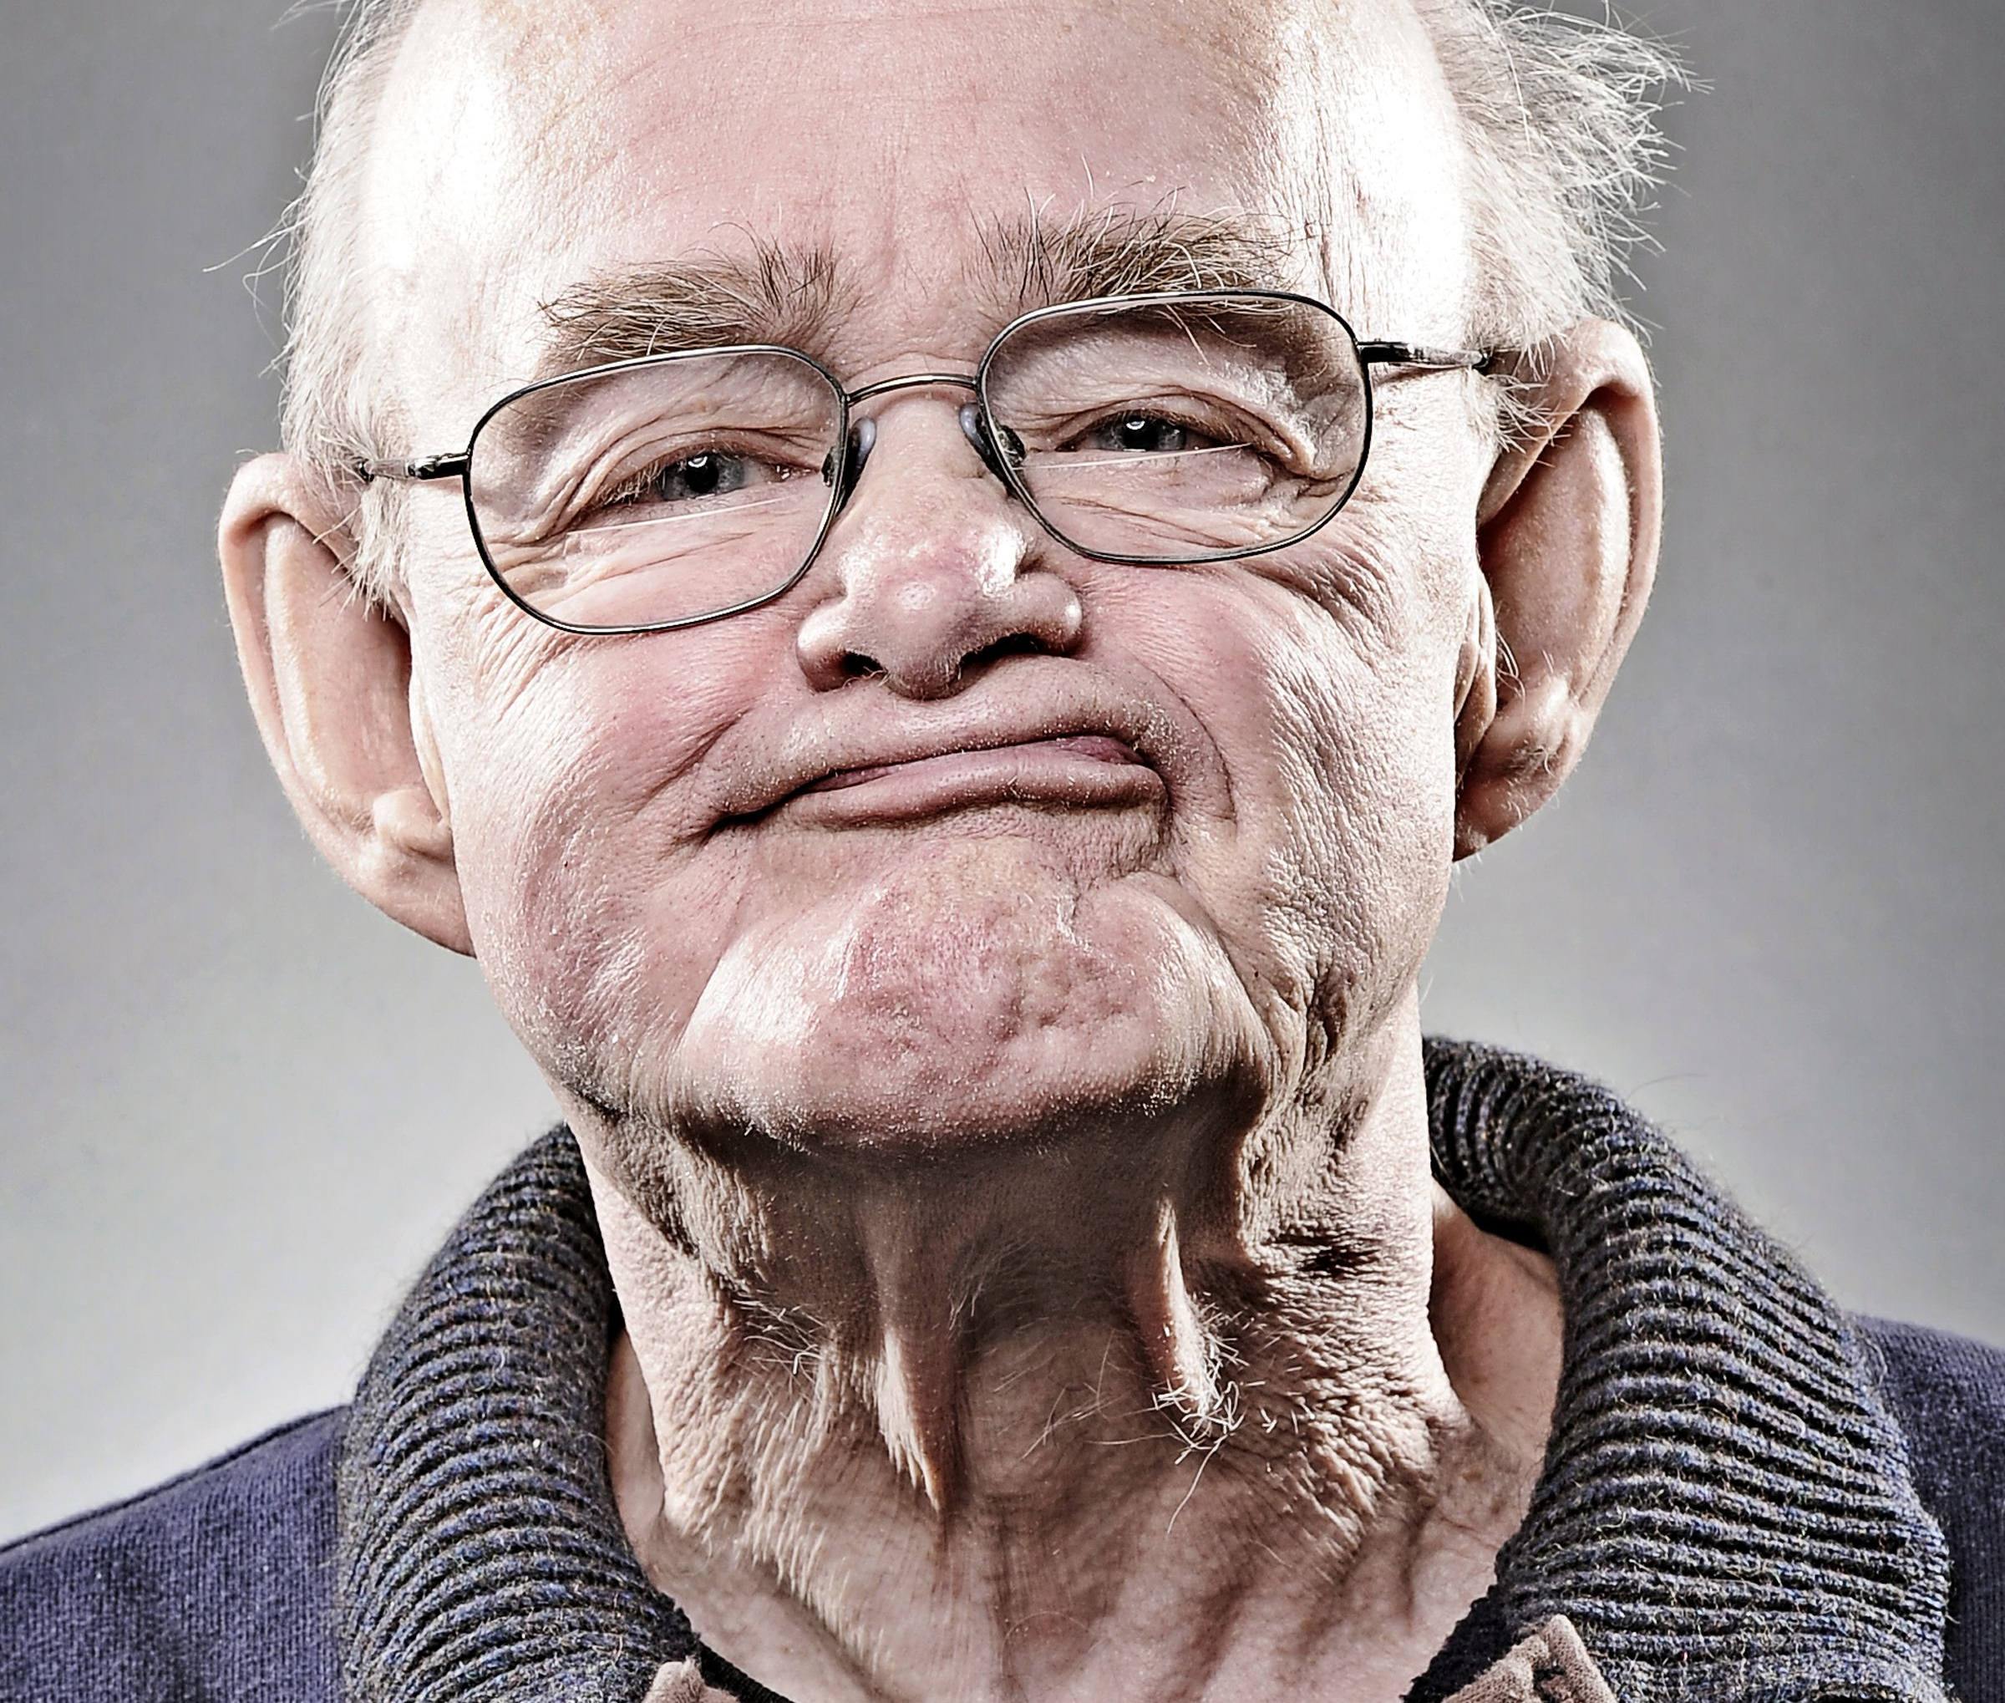
Meet our team
THE IDEA...
...was to generate a simple program working with a simple database.
Creating a team of people is sometimes hard. Random Dream Team Picker does this for you!
Andrus laansalu
Mariliis kitsapea
Idea generator
Coding genius
A shoulder to cry on
Testing
Database help
Marketing and talk
Mental help

Slide 4
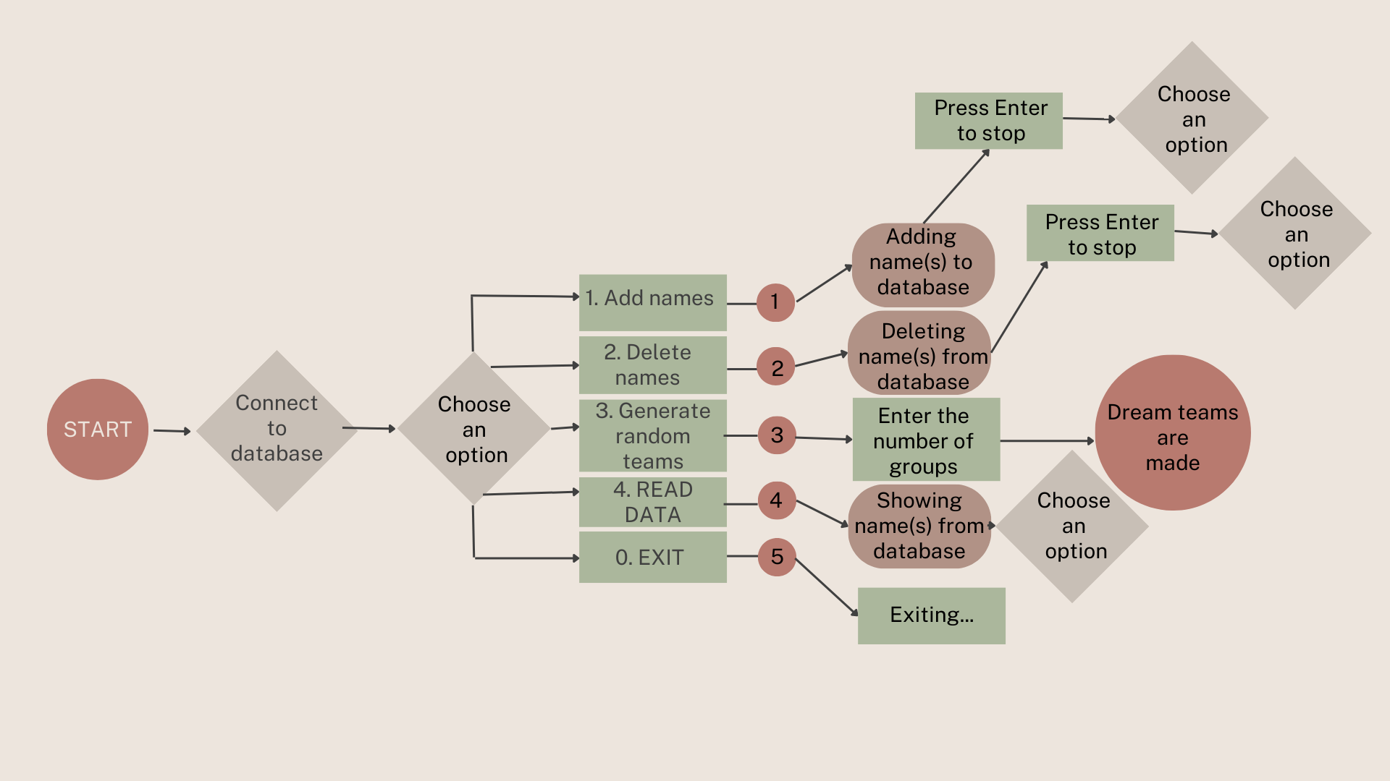
Process flow overview
Keeping things simple

Slide 5

PROS & Cons from process
Pros
Cons
Easy program for ultra-beginners
Easy database for not-so-into-programming people
Lots of new information
Maybe sometimes in the future one of us has a chance be a programmer
Teamwork – can discuss things with your teammate
Really hard week to find time for this
Small burnout
Things are not working as they should
Still not sure if it is enought to not get expelled from SDA

Slide 6
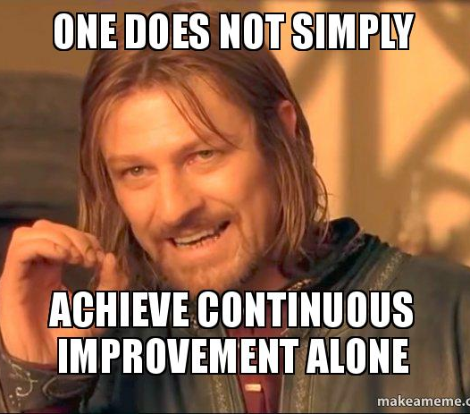
What to do next?
Improve...
Make more options to database
Make the code better
Deal with missing parts
Make options to sort the list
Clean the code from comments

Slide 7


Thank you for watching

